Slide 1

DEPARTMENT: SOFTWARE ENGEERINING
DATABASE SYSTEMS
FINAL PROJECT
SUBMITTED TO:
Miss Aqsa Umer
SUBMITTED BY:
UMER(leader)
BSE-23F-254
ADIL
BSE-23F-249
ZOHAIB
BSE-23F-134

Slide 2
Student Information System (SIS) Project
TOPIC:

Slide 3
TEAM CONTRIBUTION
ADIL
Presentation, data insertion.
ZOHAIB
Database design, tables.
UMER
SQL Queries, ER Model, submission.

Slide 4
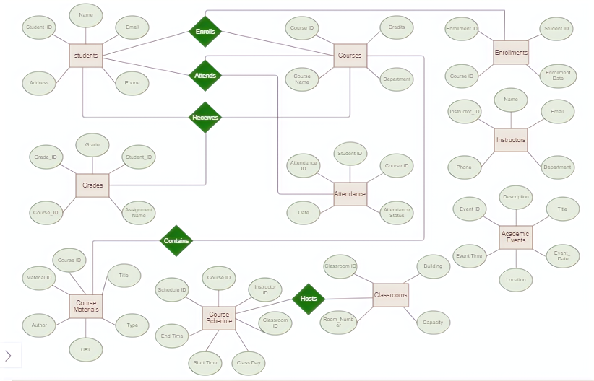
ER MODEL

Slide 5


List of Tables
Students
Courses
Enrollments
Grades
Attendance
Instructors
Classrooms
Course Schedule
Course Materials
Academic Events

Slide 6
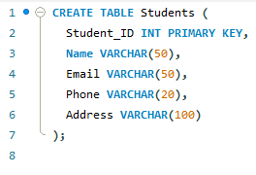
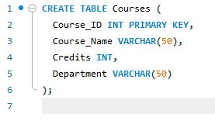
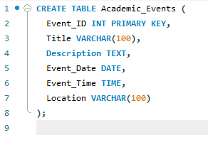
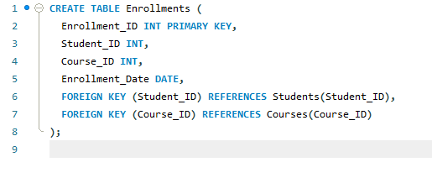
Tables

Slide 7
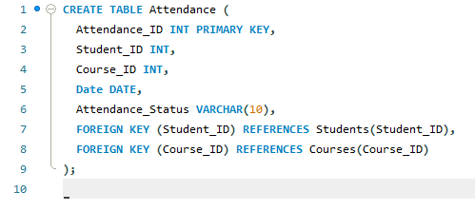
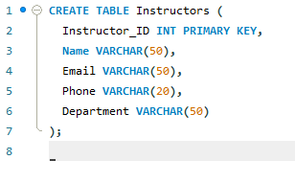
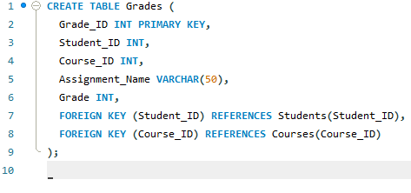
Tables

Slide 8
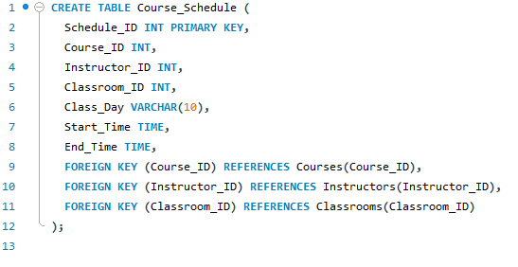
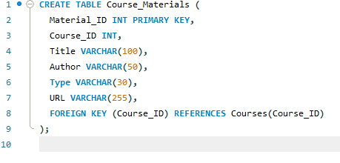
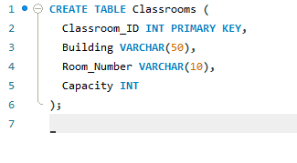
Tables

Slide 9


QUERIES
QUERY
RESULT
This query joins the Students and Enrollments tables to retrieve the names of students enrolled in the course with Course_ID = 3002.

Slide 10
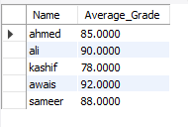

QUERIES
QUERY
RESULT
This query joins the Students and Grades tables and calculates the average grade for each student.

Slide 11
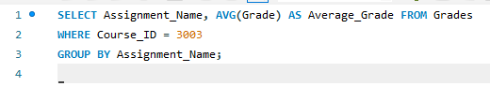

QUERIES
QUERY
RESULT
This query is designed to calculate the average grade for each assignment within a specific course. Here's a detailed breakdown of what the query does:

Slide 12

THANK YOU!

